Slide 1


AUTOMATED CUSTOMER REVIEWS

Slide 2
INTRODUCTION

Slide 3

In a world where digital reviews are growing every single day it’s becoming harder for businesses and users to keep up with the thousands of opinions shared online

Slide 4

But what if you could turn all that feedback into one smart recommendation?

Slide 5
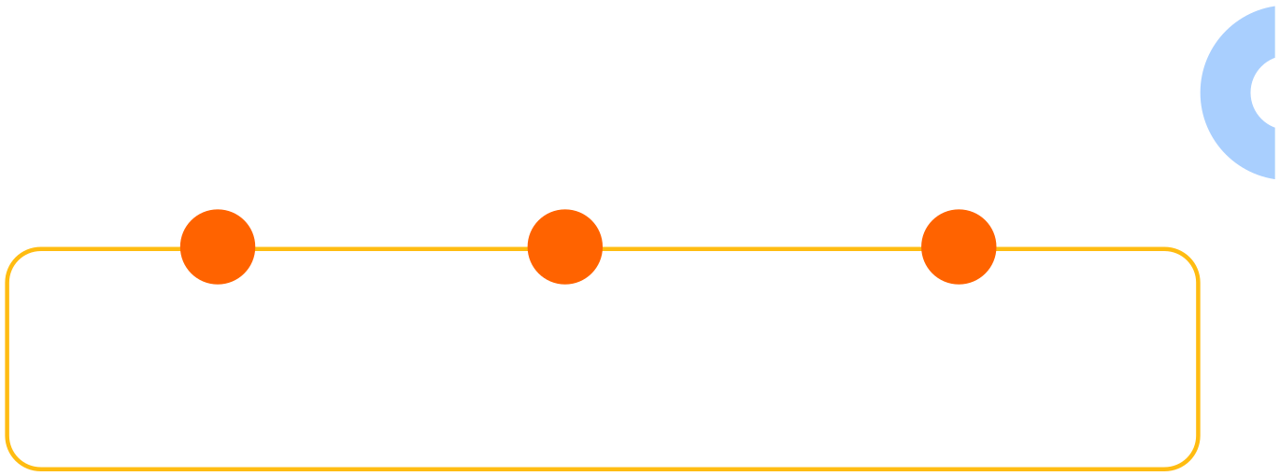
THAT’S WHERE OUR PROJECT COMES IN
Using the power of Natural Language Processing (NLP) and Generative AI, we’ve built a smart review system that can:
01
02
03
Classifies reviews as positive, neutral, or negative
Group products into clear and meaningful categories
Summarize all the feedback into short, helpful recommendation articles

Slide 6
CLASSIFICATION

Slide 7
LOAD AND PREPROCESS THE DATA

Slide 8



Step 1: Load the Dataset
I used 2 Amazon review datasets:
Datafiniti_Amazon_Consumer_Reviews_of_Amazon_ Products.csv Datafiniti_Amazon_Consumer_Reviews_of_Amazon_ Products_May19.csv

Slide 9


Step 2: Data Cleaning
I focused on two main columns: rating and review.
combine both data set
Drop rows where ether review or rating missing
Renam the columns for simplicity

Slide 10



Classifying Ratings into Sentiment Categories
Convert numerical ratings into meaningful sentiment Classes
Positive
Neutral
Negative

Slide 11
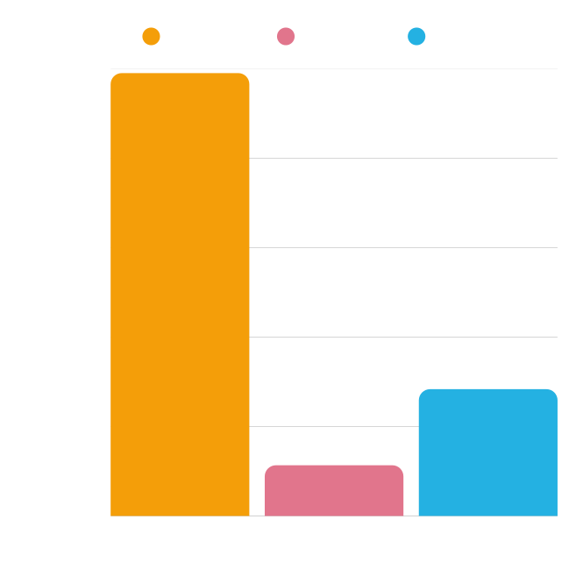
Balancing the Dataset
Positive
Neutral
Negative
The original dataset was imbalanced across sentiment classes:
300000
Positive: 30231 Neutral: 1698 Negative: 1403
200000
100000
This imbalance could negatively affect the model's performance by making it biased toward the dominant class (positive)
5000
0
Positive
Neutral
Negative

Slide 12

Balancing the Dataset
To address this issue, I applied two techniques to ensure fair learning across all sentiment classes.
down sampling: to reduce the number of positive samples into 8000
Data augmentation: to increase the number of samples on (Neutral , Negative )
Total balanced dataset: 14202 reviews

Slide 13


ROBERTA MODEL FOR SENTIMENT CLASSIFICATION
03
01
02
Construct Train/Test Datasets
The data was wrapped into PyTorch datasets for both training and testing sets
Define Evaluation Metrics
evaluated the model using accuracy, precision, recall, and F1-score per class (Negative, Neutral, Positive)
Tokenization
I used the roberta-base tokenizer to convert the training and test text data into input tokens

Slide 14
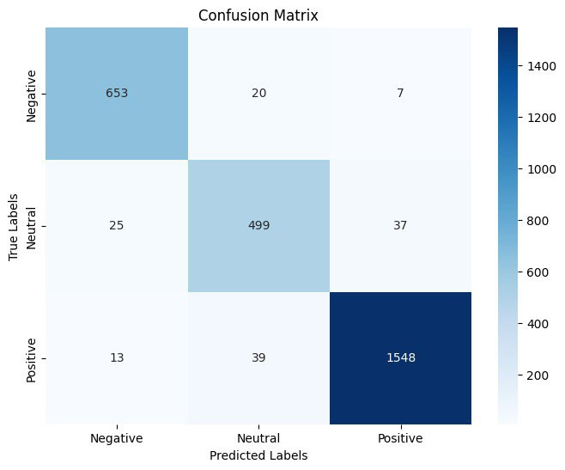
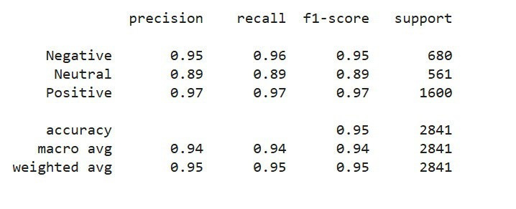
EVALUATION RESULTS
RoBERTa Classification Report:

Slide 15
CLUSTERING

Slide 16

Product Category Embedding and Clustering with KMeans
Clean and combine the product category data.
Use the all-mpnet-base-v2 transformer model to create text embeddings from the data.
Apply KMeans clustering to form six meaningful groups.
Review each group and label them with common themes such as 'Smart Home & Entertainment' or 'Tablets & E-readers.'
Use this clustering method to sort new products based on their category descriptions.
Support tasks like recommendation and auto-tagging using the categorized data.

Slide 17
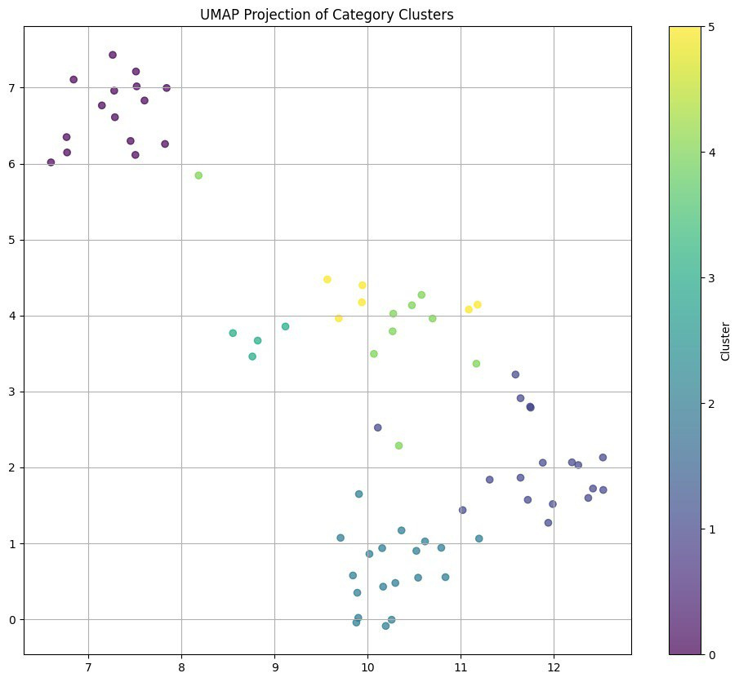
VISUALIZING CLUSTERS WITH UMAP

Slide 18
SUMMARIZATION

Slide 19

DATASET USED
For this task, I used the balanced_reviews_dataset, which was originally prepared and cleaned during the review classification task. This dataset includes:
Product names
primary categories
Review ratings
Review text
Pre-labeled sentiment classes (positive, negative, or neutral)

Slide 20
Model Used:
I used GPT-4 to produce summaries that highlight the top 3 products, key differences between them, common customer complaints, and the worst-rated product in each category. By leveraging GPT-4's generative capabilities,

Slide 21




Article for Category: Electronics
Top Products (Customer Favorites)
Fire Tablet, 7” Display
"Super lightweight"
"Easy on the eyes"
"Allows you to define words with a tap and saves them"
"Perfect for reading and learning"

Slide 22




Article for Category: Electronics
Worst Product (To Avoid)
OEM Amazon Kindle Power USB Adapter
"Overpriced (costs $19.99)"
"Feels like a scam"
"Didn’t need it — waste of money"
"A critical item sold separately — outrageous"

Slide 23


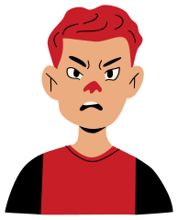

Article for Category: Electronics
Common Complaints
Amazon Echo Plus
"Built-in Hub is almost useless"
"Only discovered 2 out of 12 smart bulbs"
"Tried for 3 days — failed, but Hue Bridge worked instantly"
"Returned the product"

Slide 24
DEPLOYMENT

Slide 25

THANK YOU

